Slide 1

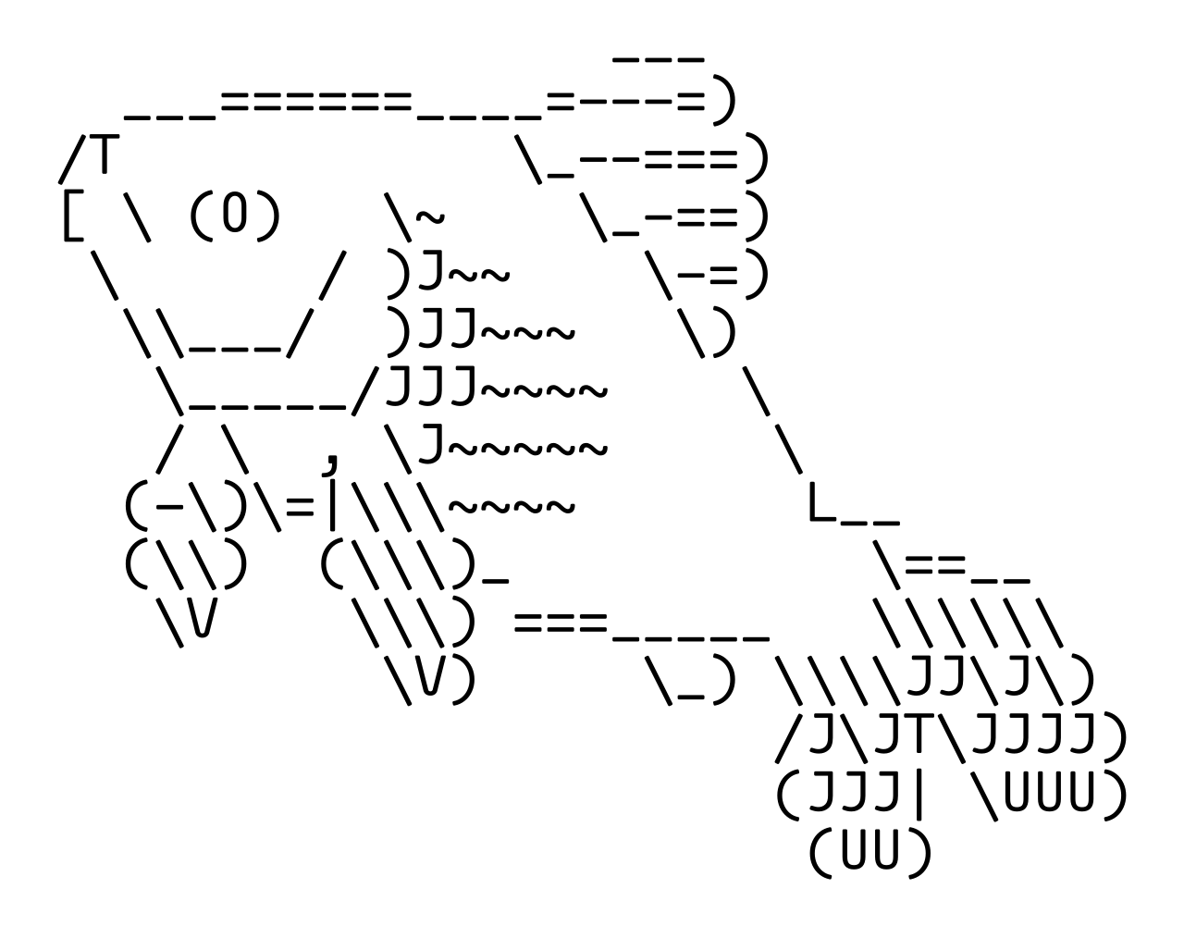
ASCII Art
What is it for?
ASCII art is the practice of arranging punctuation and symbols to create a picture, like the ‘shrug’ or drawings of animals.
While sighted users see a picture, a screen reader reads the content linearly. It cannot 'see' the image. Instead, the user hears a chaotic string of punctuation names: "Slash, backslash, underscore, vertical bar, colon..." It’s noisy and blocks them from getting to your actual content.
How to support it
You can still share these visuals, but you should change the format to be inclusive.
Take a screenshot of the ASCII art you want to share
Upload the screenshot rather than pasting the text directly
Write a description of the image as alt text (e.g. "A line drawing of a rabbit made of text characters")
Useful Links
How screen readers read special characters
RNIB - Making social media accessible
AbiHarrisonNye.dev

